Slide 1




Slide 2
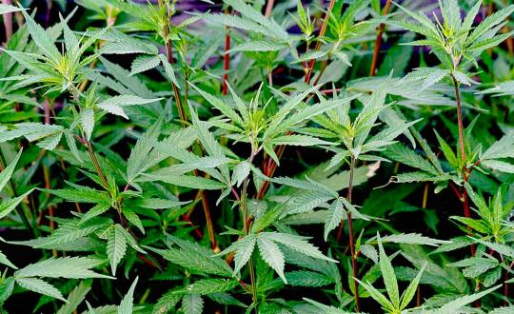
Introduction
Hash, also known as hashish, is one of the oldest and most commonly used forms of cannabis concentrate. It is made up of the trichomes of the cannabis plant - the tiny hair-like glands that produce and contain the vast majority of the plants' cannabinoids. They are separated from the plant and then pressed into concentrated blocks using pressure and heat. The vast majority of trichomes grow around the flowers of the plant, so buds and pruning residue are the main ingredients for producing hash - even though all plant material can be used to produce it. The type of plant material used also affects the final quality of the hash. Whole plants can be used to collect trichome glands and produce hash, however, it is the trichome glands collected from the buds and the small leaves around that is best.

Slide 3
Goals
1. Harvest Window: Develop a methodology to define the peak period of trichome ripeness for optimum harvest window for the production of traditional hashish.
2. Aging study: Study the impact of ageing hashish in a controlled environment to understand the evolution of the terpenes and cannabinoid over time. Define optimum shelf-life timeframe for hashish consumption, and what, if any, benefits aging imparts to traditional hashish.

Slide 4
Importance
This study is important because it will bring clarity, and data-driven results to hash producers and consumers alike. Producers can begin to understand the importance of harvest timing to get the most of out of their crops. Producers can also start to learn about the effects of aging and how they can deliver the best product to their target consumer. Consumers will be able to define their tastes, and understand what it is they are looking for in their favorite hash products. Aging is an art that is used in many industries to transform a product into something exquisite and highly sought after. The aging and harvesting processes would be unique to each producer but this study will guide producers with the how and why for creating their propieatary hash products. This study will be a step forward for the cannabis community as a whole.

Slide 5
Study Scope

Slide 6
Objective 1:Harvest Window: Develop a methodology to define the peak period of trichome ripeness for optimum harvest window for the production of traditional hashish.
To define the peak period of trichome ripeness for optimum harvest window for the production of Hashish, we will need to perform cannabinoid and terpene profile analysis on the flowers following the different harvest dates, then on the unpressed loose trichomes and finally on the pressed hashish stored at 16°C.
To obtain consistent results, 3 different Cannabis cultivars will be used for this project.

Slide 7
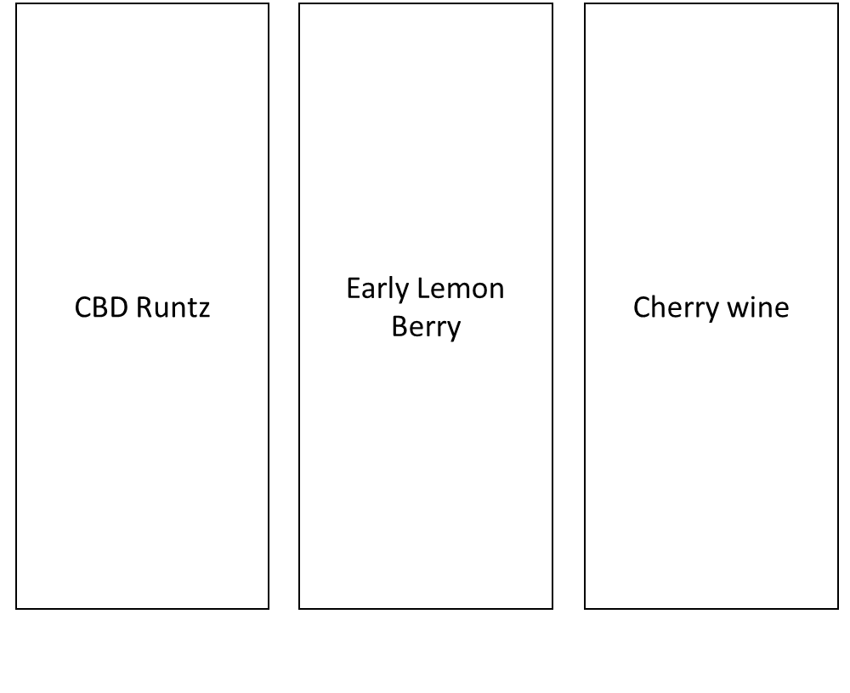
15%CBD 10% THC
22-25 %THC 0% CBD
20%CBD 0% THC

Slide 8
Objective 2:Aging study: Study the impact of ageing hashish in a controlled environment to understand the evolution of the terpenes and cannabinoid over time.
Analysis will be performed at each stage of Hash production, and each month for the stage ‘not pressed, freeze dried trichomes’ and the stage ‘Pressed: Hashish resin’ for each storage conditions.
To obtain consistent results, 3 different Cannabis cultivars will be used for this project.
N.B. The harvest window will be determined according to the preliminary results of the 1st objective.

Slide 9
Expected Results
Define the optimum harvest window for peak trichome development for high-quality hashish production.
Define if the harvest date parameter is influenced by the cultivar used.
Identify the effect of aging hash on its cannabinoid and terpens content.
Identify the best environmental conditions for the hash aging.
Check the best way of aging hash, by storing it in the form of trichomes or in the form of pressed hash.

